Slide 1

Project 3 The Job Search Helper
Emily coxon
Jonathon wood
Sandra reyes

Slide 2
A job seeker has enlisted our help to find suitable listings in their preferred job field, what area the job is in and what buzzwords the various listings use

Slide 3
To solve this problem, we will create a interactive flask app for the user to view all the data and visualisations. These visuals can be manipulated depending on requirement.

Slide 4
Our Approach: Scrape job listings from Seek.com.au Transform data for loading/plotting Load to Postgresql Database Create Flask App for the end user

Slide 5
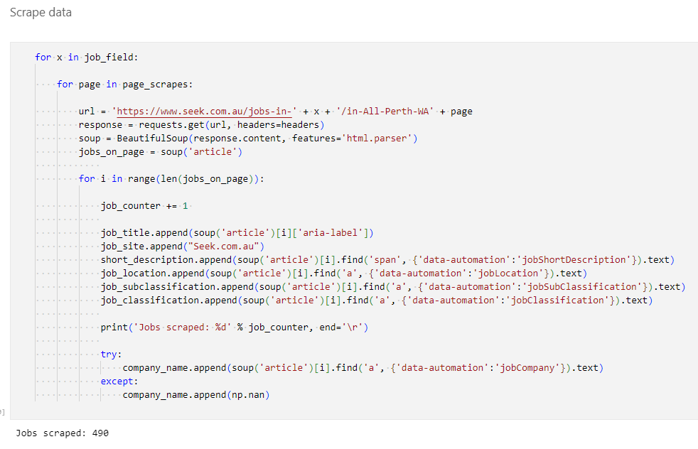
Seek Webscraping
Jobs Scraped from seek using BEAUTIFUL SOUP
Webscraping blocker avoided by adding header to request.

Slide 6
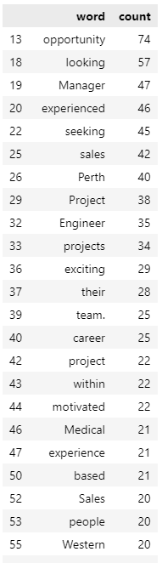
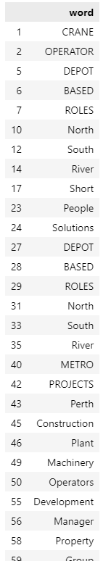
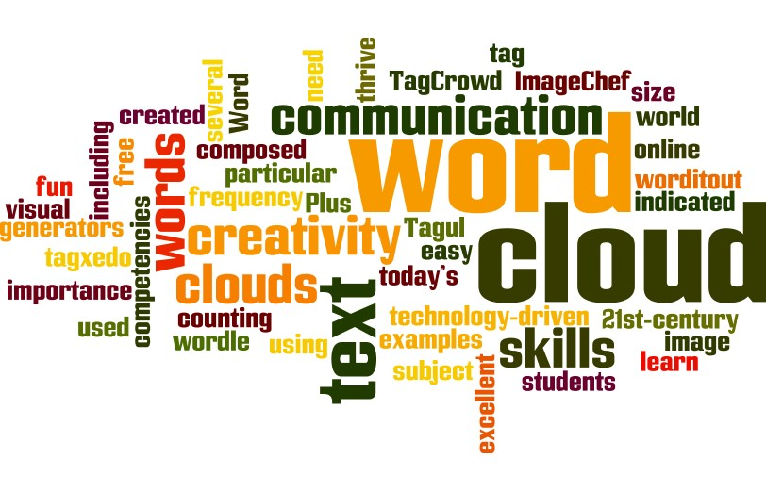
Data Transformation - Buzzwords
DATA FOR WORDCLOUD PLOT
Words tallied and table created for both buzzword list and count
This was repeated for each job field

Slide 7
Data Transformation - Locations
Job locations tallied
This was repeated for each job field

Slide 8
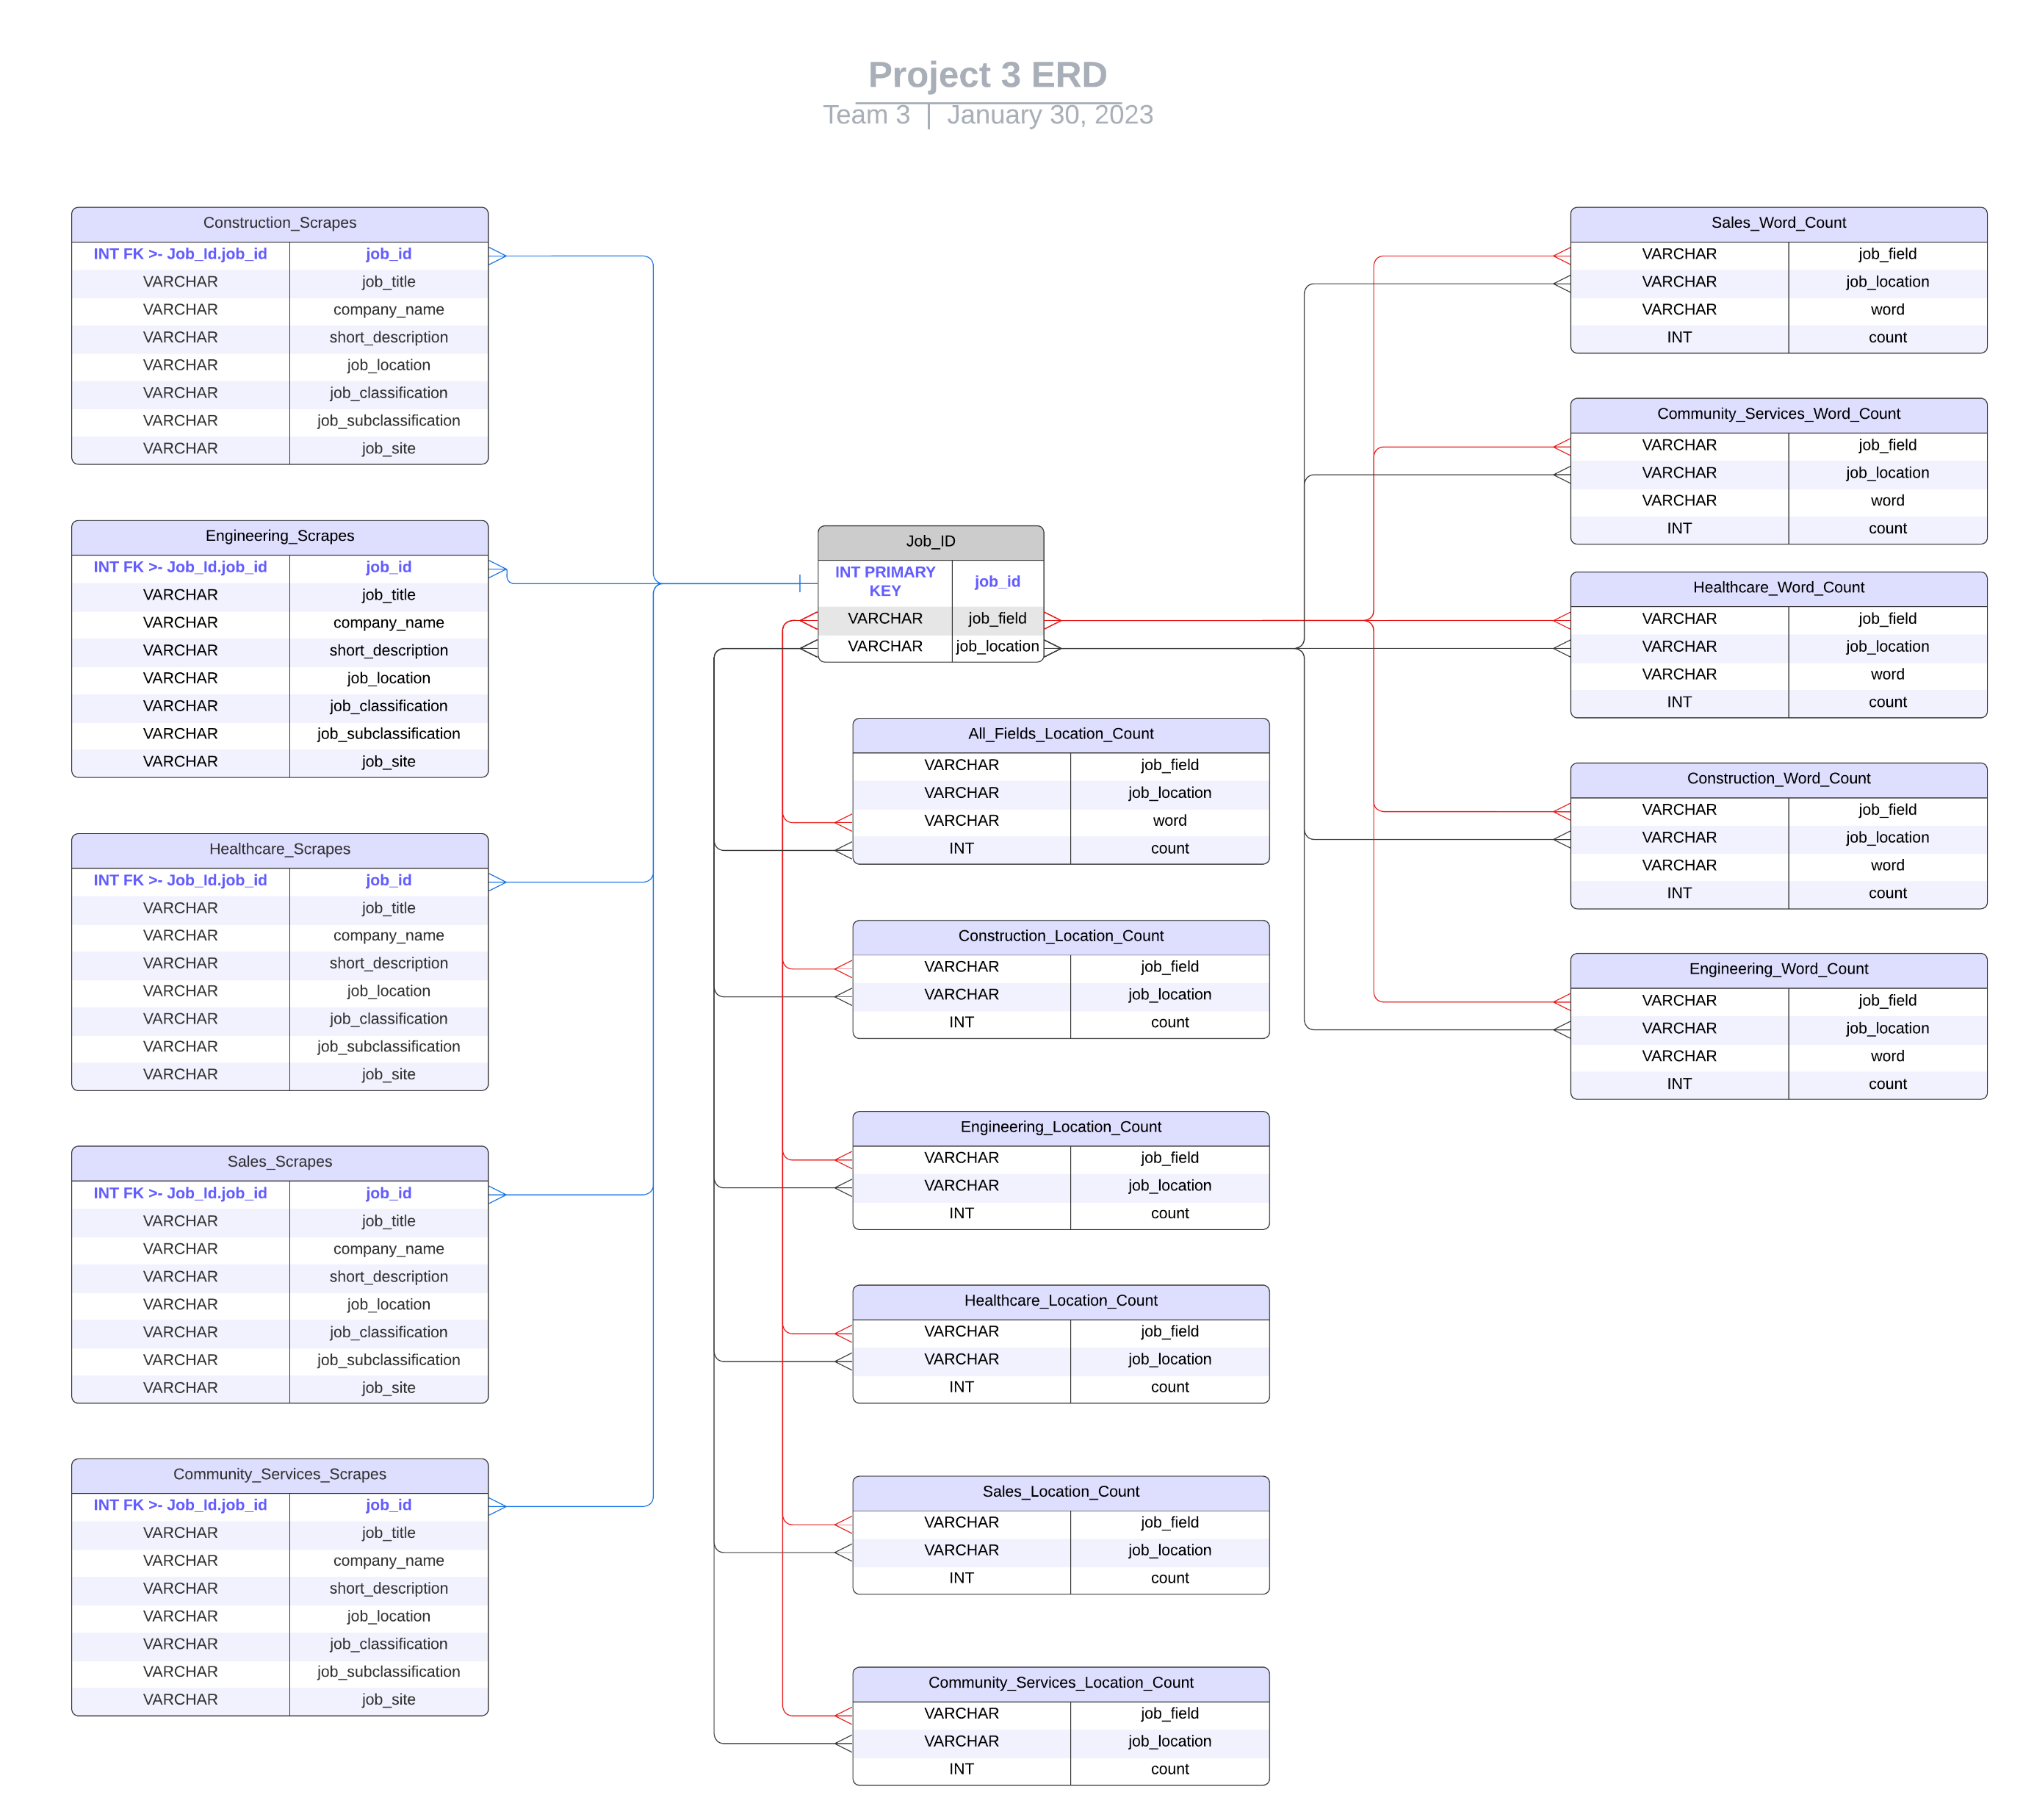
Database Diagram
Tables created with data for plotting, and for any future queries as required.
Tables are linked via JOB ID table.

